Slide 1

Welcome to:
General Meeting
5 PM Tuesday, August 21, 2018
Broun Hall, Room 235

Slide 2

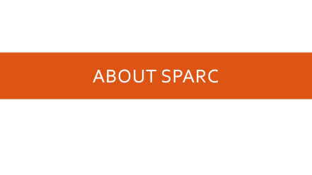
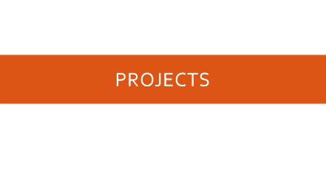
Agenda

Slide 3
About SPARC

Slide 4
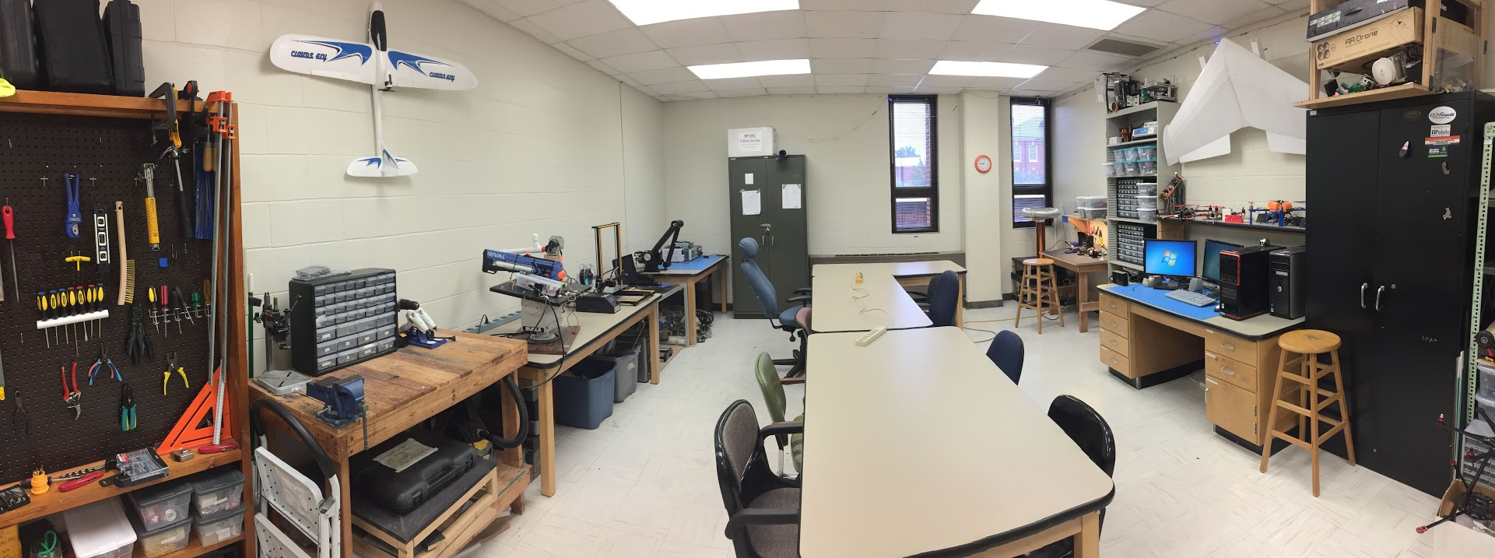
About SPARC
Creates and fosters an environment of creativity and innovation through collaborative projects.
A place to test out ideas, integrate concepts learned in class, and learn skills that will be instrumental when working in the workforce.
No prior experience is required, only a willingness to learn.
Join by logging 5 constructive hours in the lab on clipboard next to door and email sparc.auburn@gmail.com.
Lab:
- Broun 367
General Meetings:
- Tuesdays @ 6 in Broun 125
Project Meetings:
- Various Times during week

Slide 5


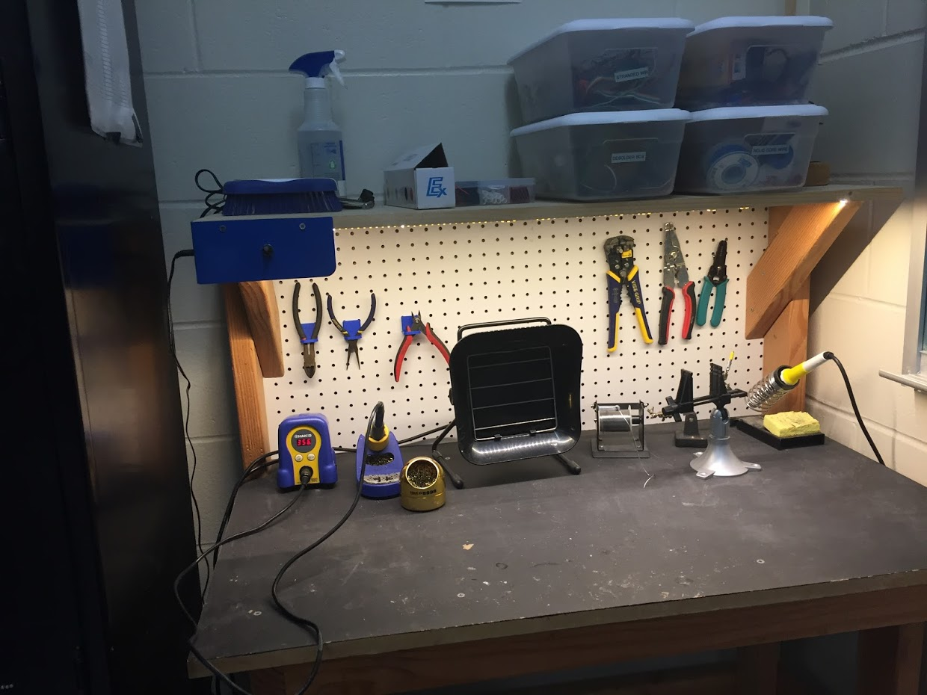
Our Lab
Broun Hall
Room 367

Slide 6
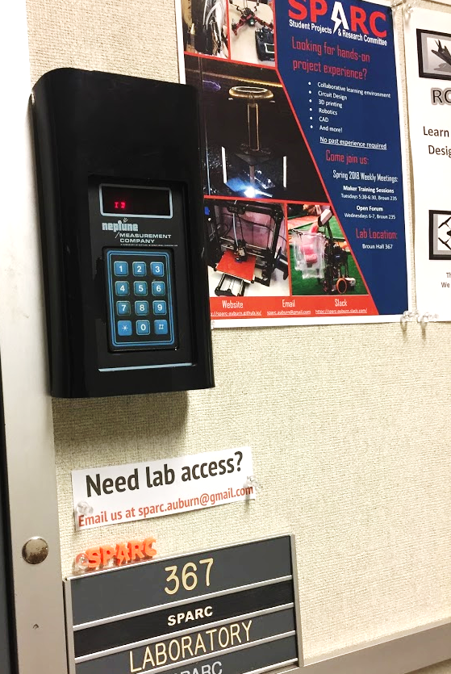
How to become a Member
Log 5 constructive hours in the lab
Write the times on the sheet on the clipboard next to the door.
Contact us at sparc.auburn@gmail.com
We will respond with the instructions to get an access code.

Slide 7




More Information about SPARC
Website
http://sparc.eng.auburn.edu/
Github
https://github.com/SPARC-Auburn
Slack
https://sparc-auburn.slack.com/
Email
sparc.auburn@gmail.com

Slide 8
Outreach and Recruitment

Slide 9
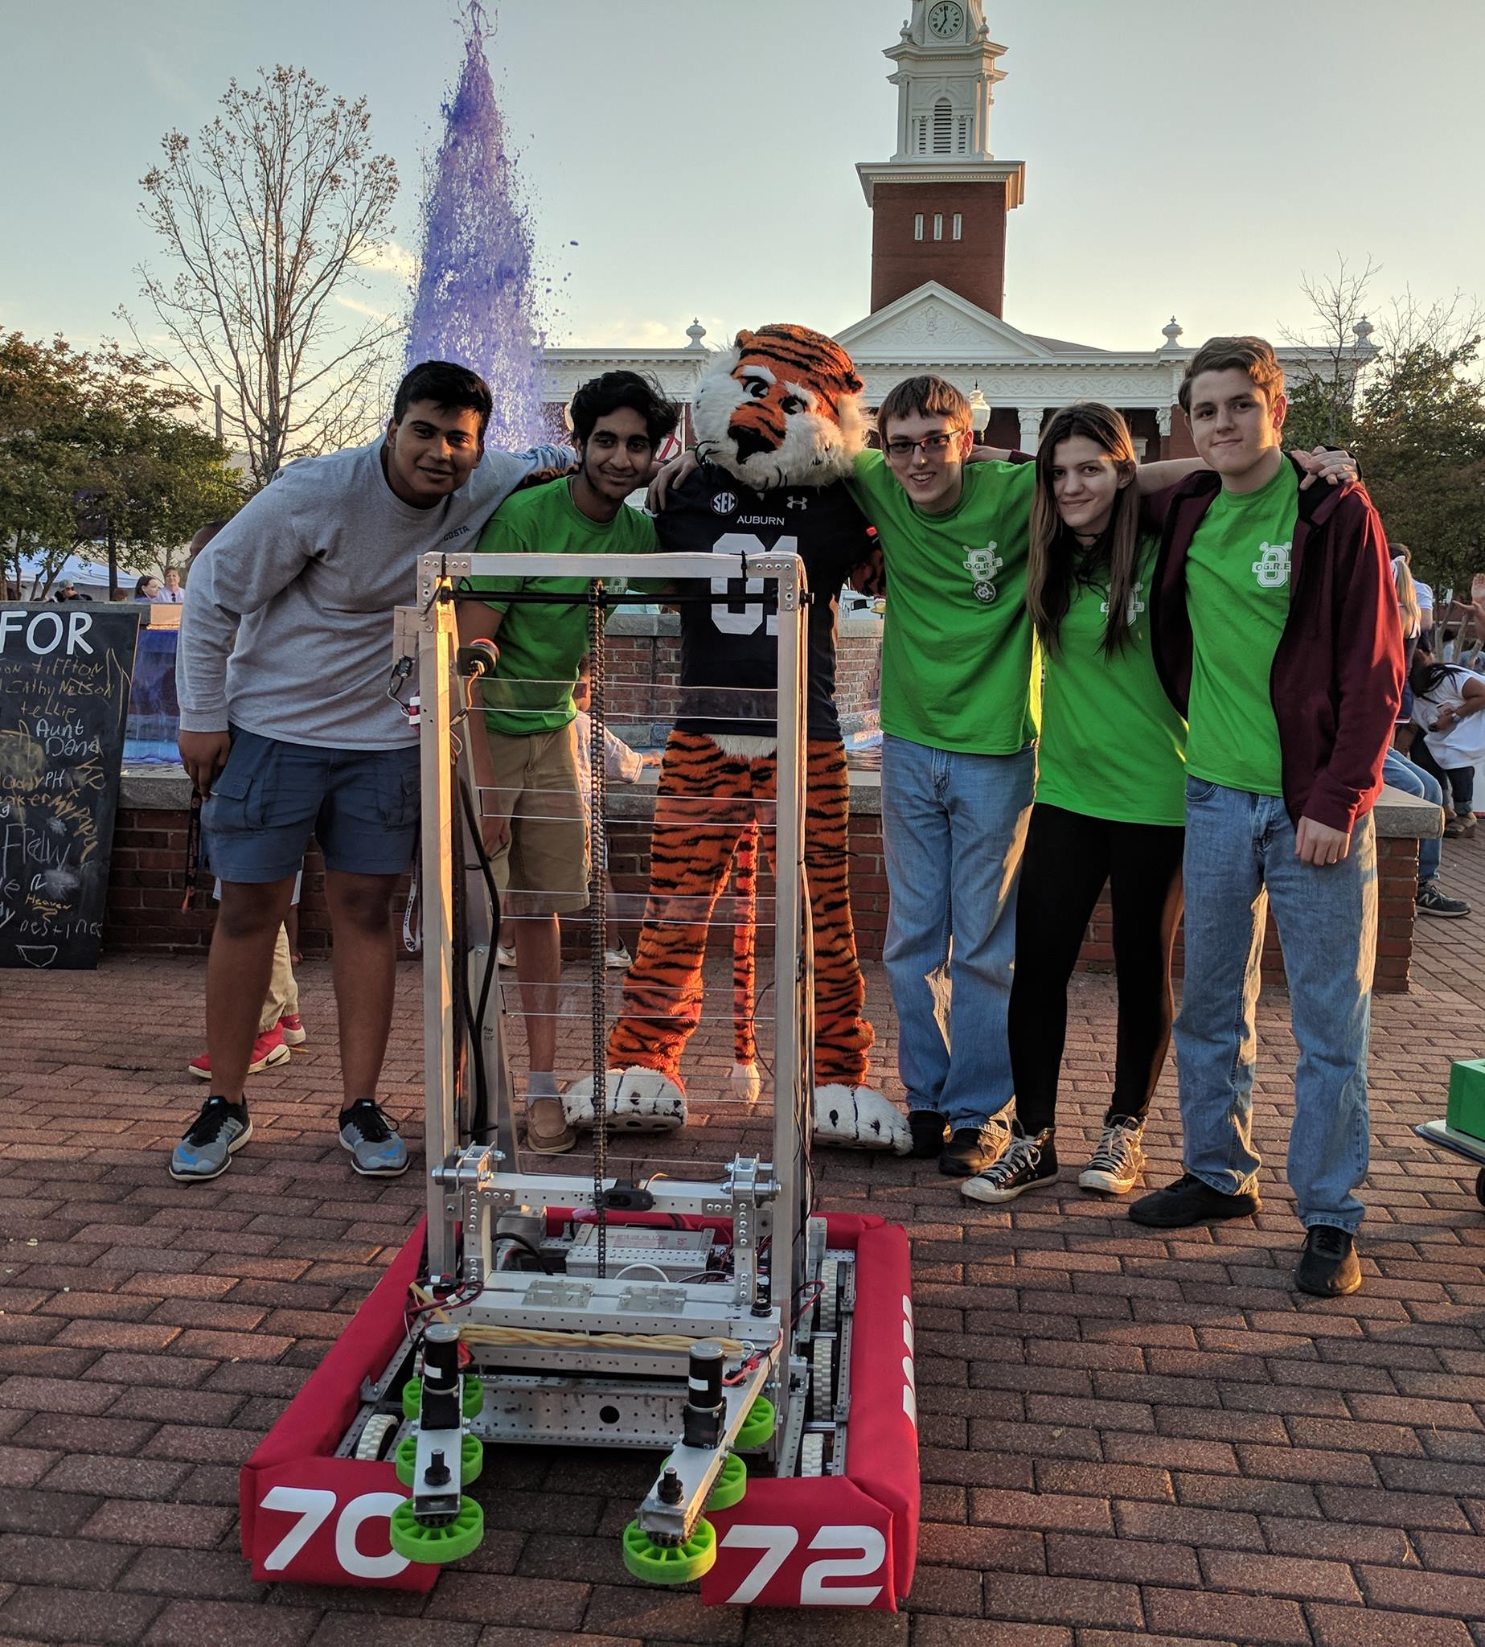
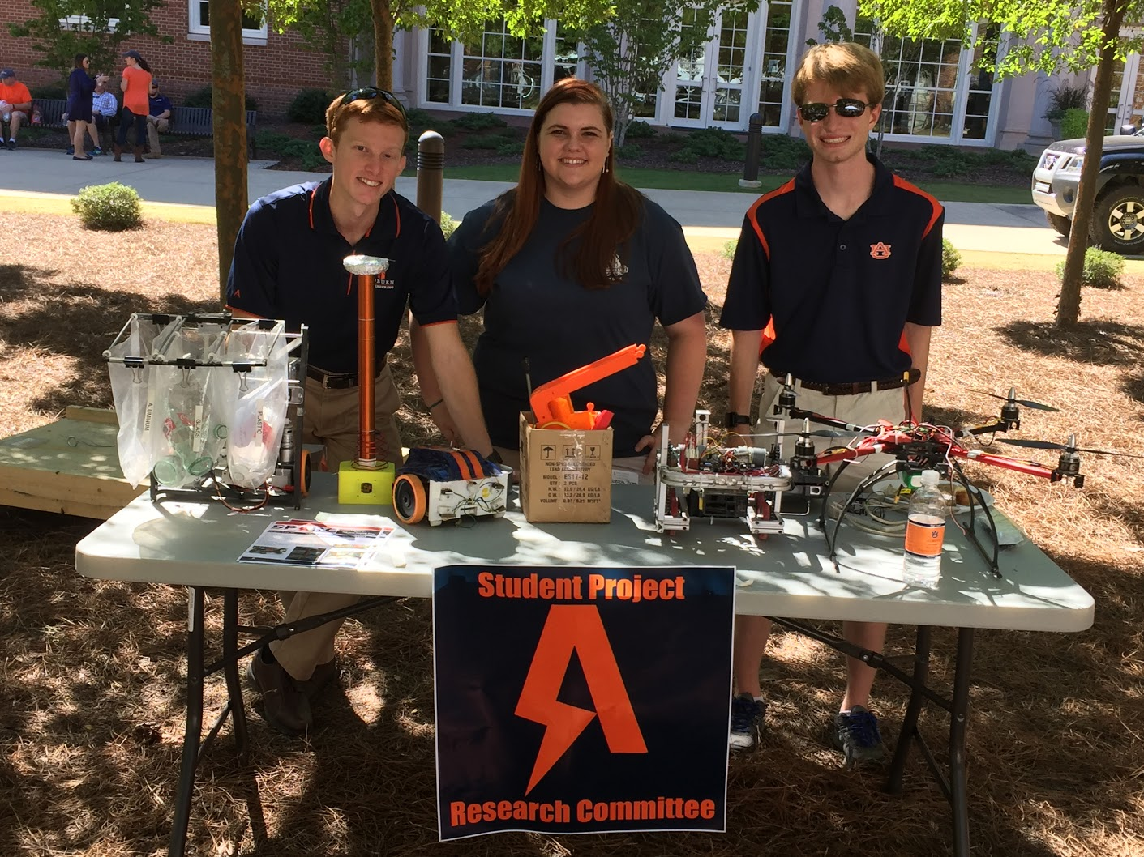
Upcoming Events
Opelika HS Robotics Team
Help mentor a local robotics team
Times: TWR: 3:30-6:30pm
Contact: Matthew Zacune <maz0006@auburn.edu>
Engineering BBQ SPARC Table
Help recruit new members to join SPARC
Free food provided by College of Engineering
Friday, August 24th: 10am-2pm
O-Days Concourse Tables
Monday and Tuesday, August 27-28th 10am-2pm.
We need all hands on deck for these events
Sign-up Link:
https://goo.gl/forms/GwWm2dNg2RFFzJkm2
FRC Team 7072 Bot
Engineering Tailgate 2016 SPARC Table
Notes:
Fall 2016
Loachapoka Robotics Mentoring- Mondays, Tuesdays, and Thursdays 3:00PM to 4:30PM
ECE Minority Presentation- November 14th
AJHS E-Day- November 17th
South’s Best- December 3-4th
SCORE Claw Machine- December 3-4th
Spring 2016
E-Day- Late February or early March
SPACE Day- Possible Event Next Semester
IEEE Sumo Robotics Competition (with local middle and high schools)- Spring 2017

Slide 10
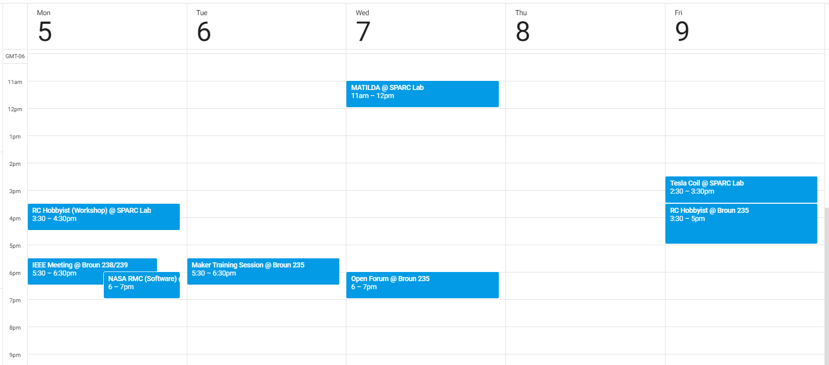
Meetings this Week

Slide 11
Projects

Slide 12
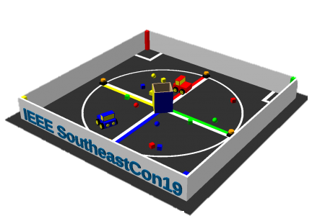
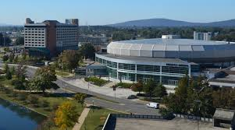
Project: IEEE Southeast con
Project lead: Matthew Castleberry
Electrical lead: Josh Jablonowski
Mechanical lead: Alex Jones
Slack Channel: #projectieee
Competition Details:
Build a “space debris” collecting robot
Goal is to collect wood blocks and ball pit balls and deposit them on the side of a small flat ~100” square arena autonomously.
Max dimensions: 9” x 9” x 11”
When and Where:
Thursday, April 11th, 2019 through Sunday, April 14th, 2019.
IEEE Southeastcon conference in Huntsville, AL
Meeting Times
Electrical/Software Meeting: TBD
Mechanical Meeting: TBD

Slide 13
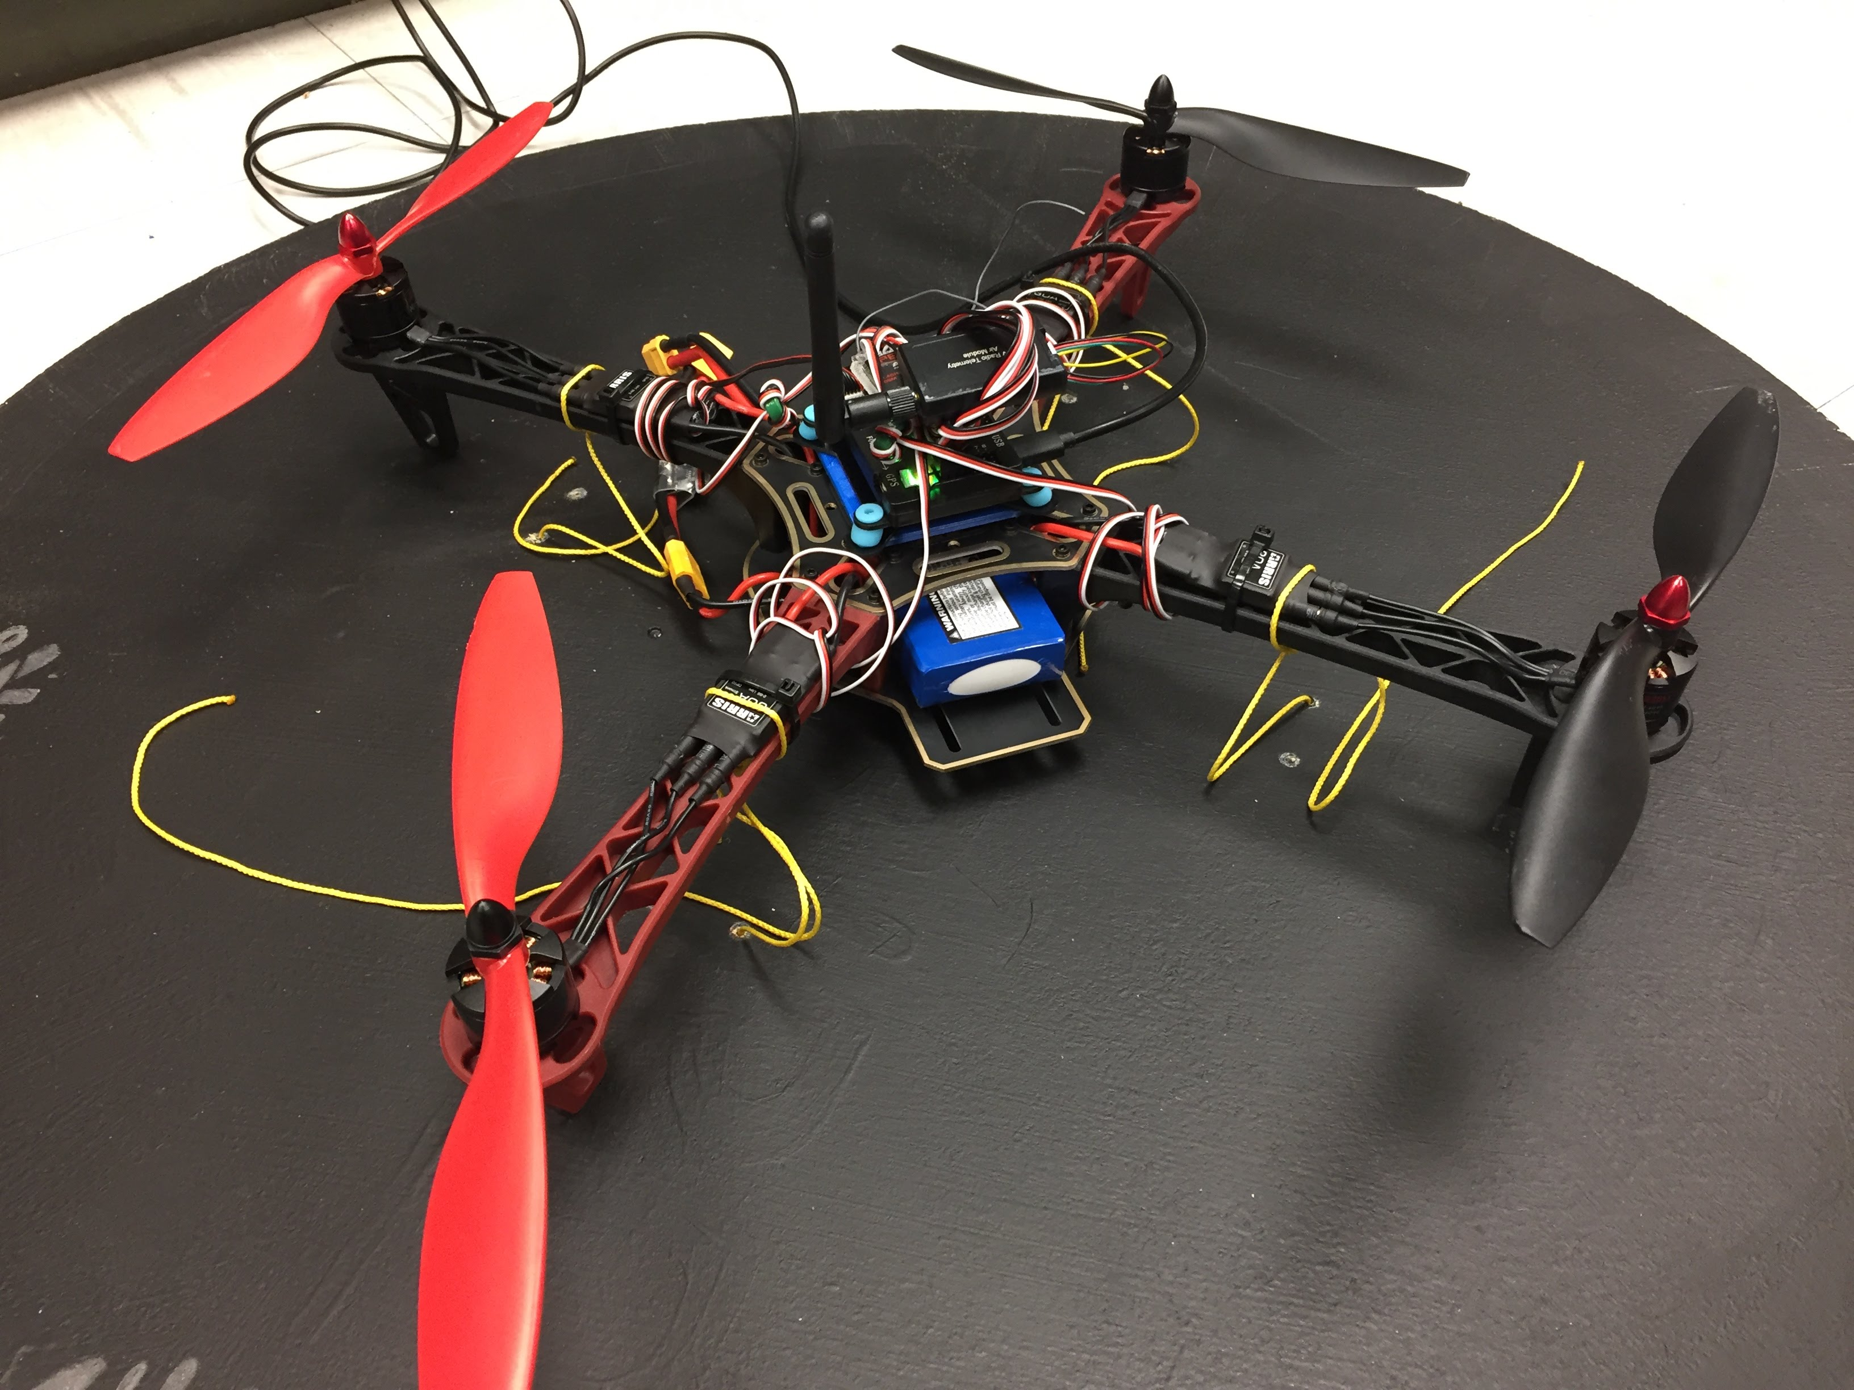
Project: Mail Bird
SPARC Project Lead: TBD
RCHC Project Lead: TBD
Slack Channel: #projectmailbird
Partnership with RC Hobbyist Club
Will be used to experiment with payload pickup, identification, and delivery
Semester Focus
Select frame to use as platform
Develop package release mechanism
Meeting Times
TBD

Slide 14
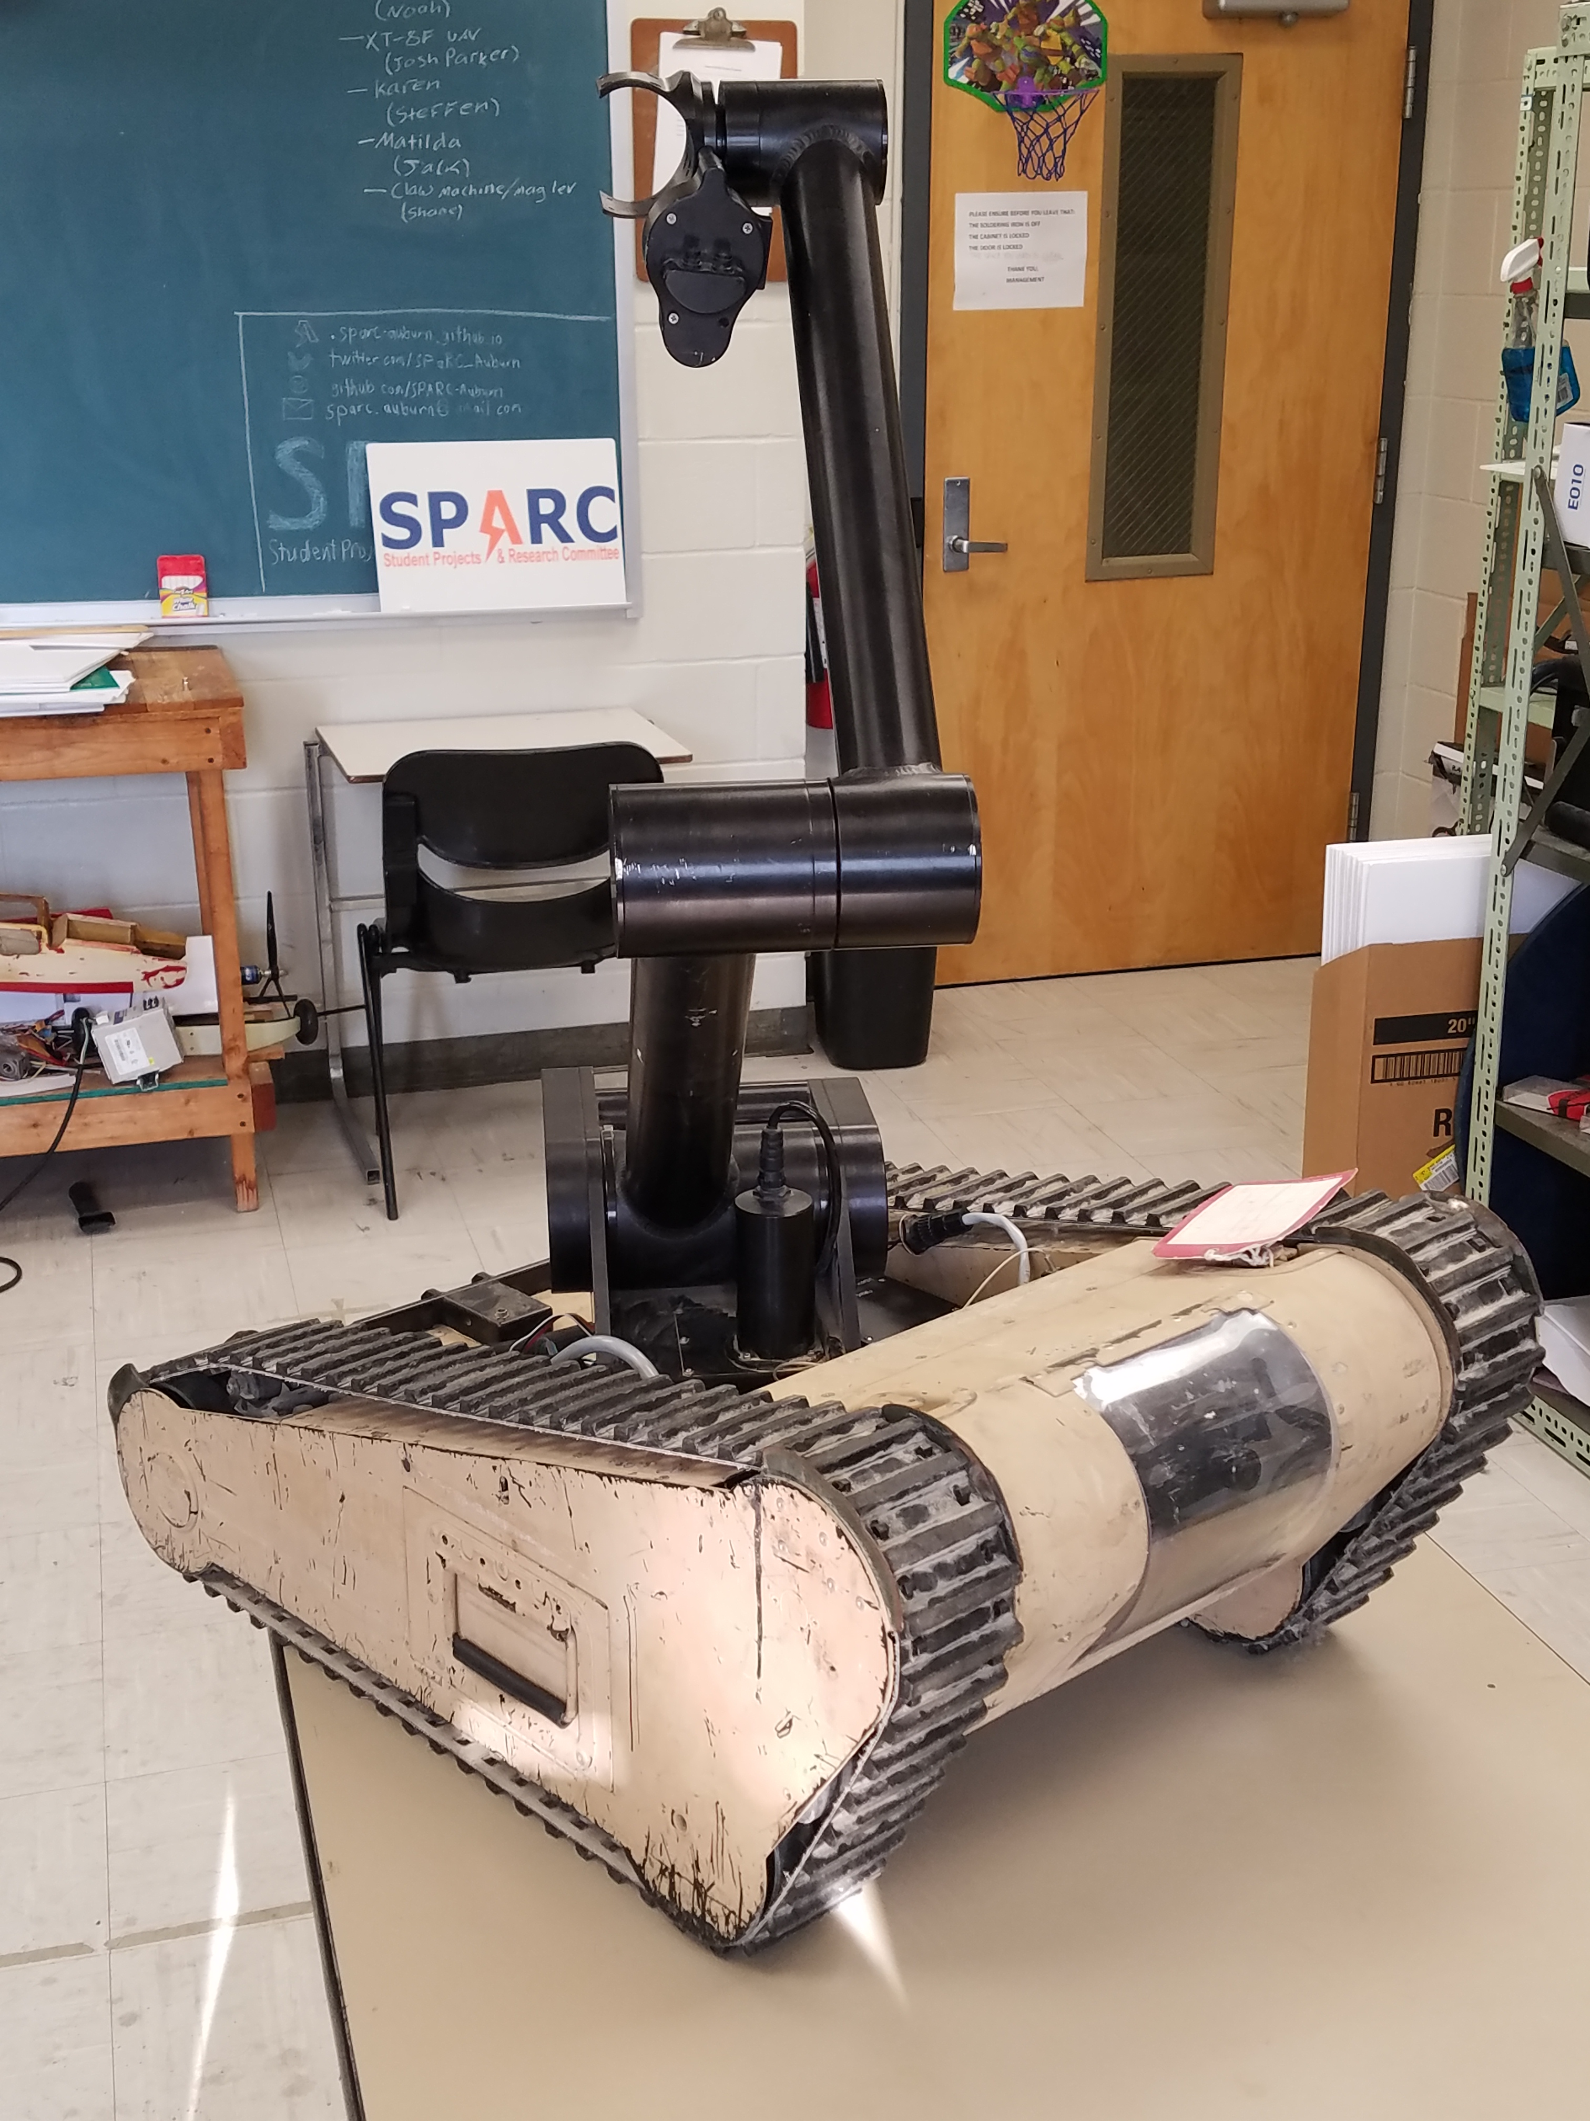
Project: MATILDA
Project lead: TBD
Slack Channel: #projectmatilda
MATILDA stands for Mesa Associates' Tactical Integrated Light-Force Deployment Assembly
A bomb disposal robot from Dr. Roppel’s research lab.
Is in disrepair both electrically and mechanically.
Arm is functional and controllable via Arduino.
Semester Focus
Reestablishing mobility.

Slide 15
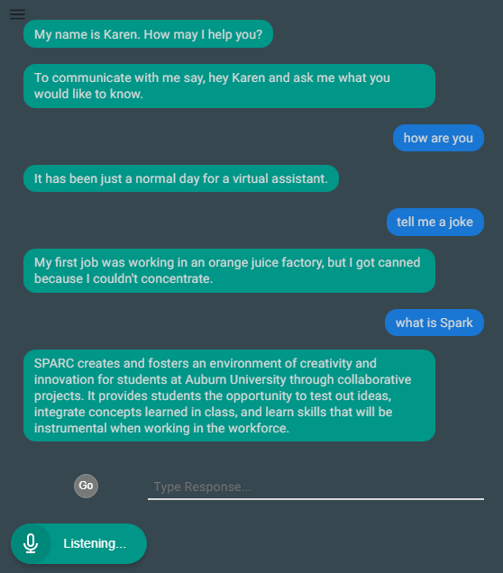
Project: Lab Assistant
Kinematic
Autonomous
Robot
Enriches
Newcomers
Lab
Information
Support
Tool
Project lead: TBD
Slack Channel: #projectlabassistant
Goal: create an automated lab assistant.
Is voice controlled.
One day will consist of both a stationary and mobile system.
Can be embedded on the new group chat system Slack.
Programmed in Node.JS (Framework of JavaScript)
Semester Focus
Add functionality
Add database for keeping track of members and equipment
Slack Channel
#projectlabassistant

Slide 16
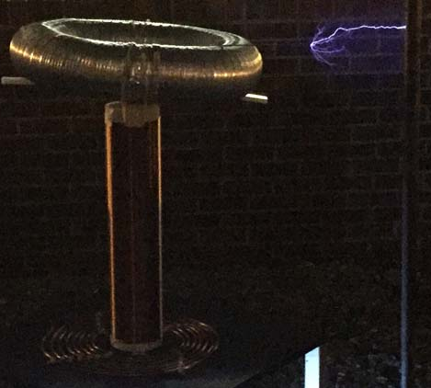
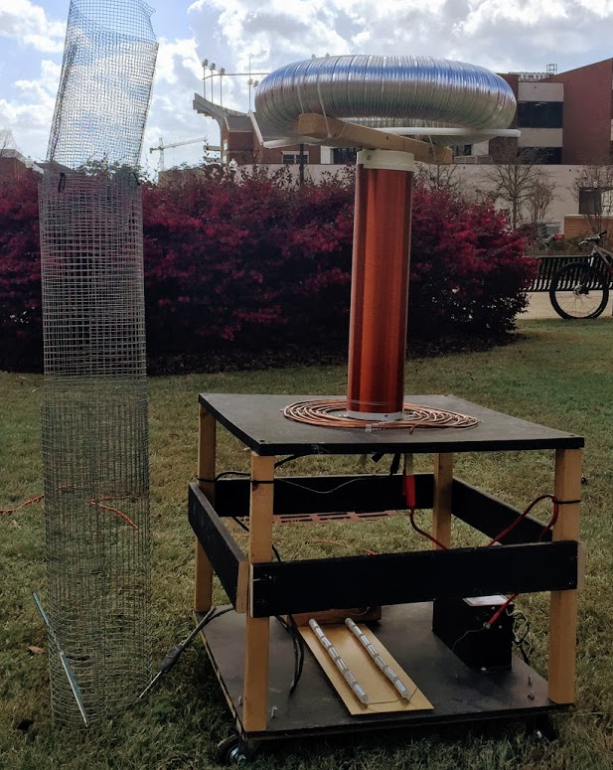
Project: Tesla Coil
Project lead: TBD
Slack Channel: #projectteslacoil
Demonstrated Tesla Coil at Spring 2016/18 E-Days
Currently uses spark gap style circuitry
Generated estimated 400,000 volts of electricity.
Semester Focus:
Convert it into a musical Tesla Coil.
Develop circuit and PCB design for new components

Slide 17
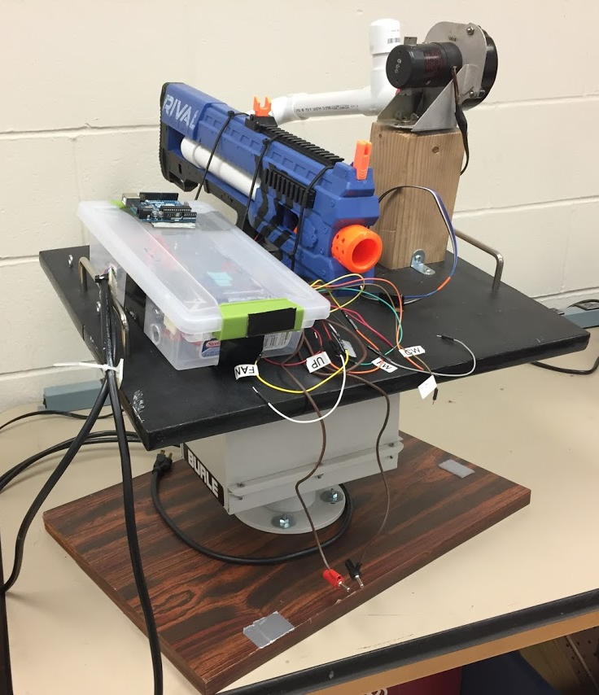
Project: Automate Nerf Turret
Project lead: TBD
Slack Channel: TBD
Old project donated by EE department
It was demonstrated last spring at E-Day and PEAK.
Needs a new purpose to improve demonstrations

Slide 18
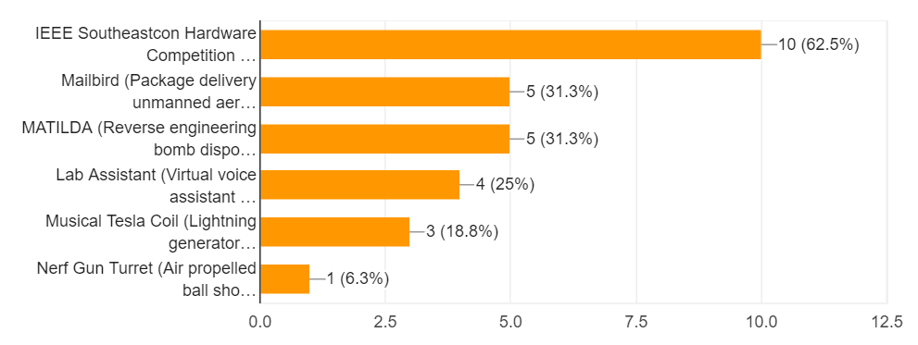
Project Interest
Existing Project Interest
Other Project Ideas
3D print enclosure
3D printed Vertical axis wind turbine (VAWT)
Open source hardware creation w/ 3D printing

Slide 19
Project Selection
Major Projects (no more than 15 people)
IEEE Southeastcon (Lead: Matthew C., Josh J., Alex J.)
Mailbird (Lead: Ryan M.)
MATILDA (Lead: ______________)
Side Projects (2-4 people)
3D print enclosure (Lead: Josh J., Alex J.)
Musical Tesla Coil (Lead: ______________)
3D printed Vertical axis wind turbine (VAWT) (Lead: ______________)
Personal Projects (1 person)
Open source hardware creation w/ 3D printing (Lead: Alex Jones)
Lab Assistant / L.I.S.T. (Lead: Matthew Castleberry)

Slide 20
Questions?

